Slide 1
Low Depth Cache-Oblivious Algorithms
Guy E. Blelloch, Phillip B. Gibbons, Harsha Vardhan Simhadri
Slides by Endrias Kahssay

Slide 2
Why Parallel Cache Oblivious Algorithms?
Modern machines have multiple layers of cache – L1, L2, L3.
Roughly 4 cycles, 10 cycles, and 40 cycles respectively.
L2 and L1 are private, L3 is shared across CPUs.

Slide 3
Depiction of Architecture

Slide 4
Why Parallel Cache Oblivious Algorithms?
Hard to manually tune for – because of scheduler and shared caches.
Parallel programs are often memory bound.
Natural extension to processor oblivious code.

Slide 5
Paper Contributions
First parallel sorting, and sparse matrix vector multiply with optimal cache complexity and low depth.
Applications of parallel sorting for solving other problems such as list ranking.
Generalization of results to multilayer private and shared caches.

Slide 6
Parallel Cache Complexity
Qp(n; M,B) < Q(n; M,B) + O(pMD/B) with high probability for private caches, work-stealing scheduler.
Qp(n; M +pBD, B) ≤ Q(n; M,B) for shared caches.
Results carry over to fork-join parallelism (e.g Cilk).

Slide 7
Recipe for Parallel Cache Oblivious Algorithms
Low depth, and low serial cache complexity.
Optimizes for both serial and parallel performance.

Slide 8
Parallel Sorting
Optimal cache bound is
Prior serial optimal cache oblivious algorithms would have Ω(√n) depth under standard techniques.
Paper proposes a new sorting algorithm with optimal cache bound.

Slide 9
Primitives
Prefix Sum with logarithmic depth and O(n/B) cache complexity.
Merge sort with parallel merge based on picking O(N^{1/3}) pivots using dual binary search, and achieves O((n/B) log (n/M)) cache complexity.
Transpose in logarithmic depth and O(nm/B) cache complexity.

Slide 10
Deterministic Sorting
Based on sample sort; selects a set of pivots that partition the keys.
Routes all the keys to the appropriate buckets; main insight of the paper is how to do this in O(log²n) depth.
Sort each bucket.

Slide 11
Deterministic Sorting
Split the set of elements into √n subarrays of size √n, and recursively sort them.
Choose every (log n)-th element from each of the sub arrays as pivot candidates.
Sort the O(n/log n) pivot candidates using merge sort.
Choose √n pivots.

Slide 12
Deterministic Sorting
Use prefix sums and matrix transpositions to determine where buckets should go.
Each bucket will have at most O(√n log n) elements.
Use B-TRANSPOSE which is a cache oblivious recursive divide conquer algorithm to move elements to the right buckets.

Slide 14
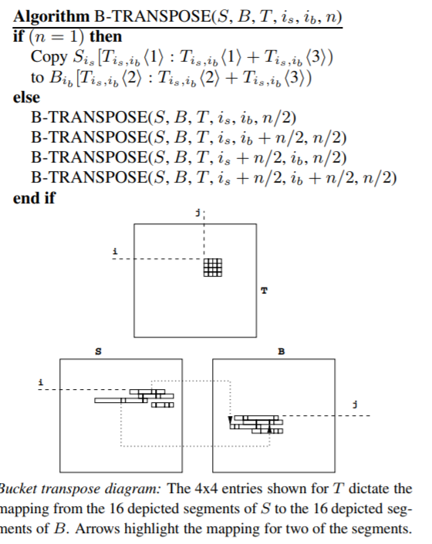
Transpose Complexity
B-TRANPOSE transfers from a matrix of √n × √n keys into the √n in O(log n) depth, and O(n/B) sequential cache complexity.

Slide 15
Analysis
For each node in the recursion tree, define s(v) to be n²; the size of the submatrix T.
Define w(v) to be the total weight of the keys that the submatrix T is responsible transferring for.

Slide 16
Analysis
Light-1 Node: if s(v) < M/100, w(v) < M/10, and S(parent node) >= M/100
Light-2 Nodes: if s(v) < M/100, w(v) < M/10, and S(parent node) >= M/10
Heavy leaf: if w(v) >= M/10.

Slide 17
Analysis
Each node in the recursion tree is accounted in the sub tree of this three nodes.
There are 4n/(M/100) light 1 nodes; each incur M/B cache miss.
Let W be the weight of all heavy leaves. Then all heavy leaves incur < 11W/B misses.
There are 4(n-W)/(M/10) light 2 leaves, and in total incur O(40 (n-W)/B) cache misses.

Slide 18
Analysis
Heavy + Light 2 + Light 1 <= (40 (n-W)/B) + 11W/B + N/B <= O(N/B)
Total cache miss is thus O(N/B).

Slide 19
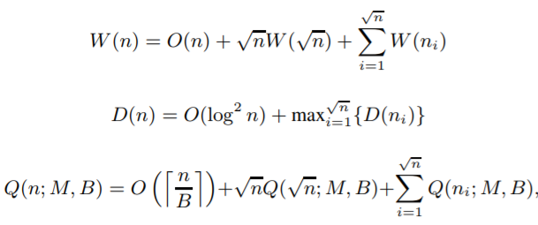
Deterministic Sorting Analysis
Recurrence solves to: Q(n; M,B) = O(n/B* log_{M}n ) sequential cache complexity, O(n log n) work, and O(log² n) depth.

Slide 20
Randomized Sorting
Pick O(√n) pivots randomly.
Repeat picking of pivots until the largest block is < 3 √n log n.
Paper shows with high probability, the algorithm has the same sequential cache complexity, O(n log n) work, and O(log ^{1.5}n) depth.

Slide 21
Generalizing to Multiple Caches
We look at the PMDH model which stands for Parallel Multi-level Distributed Hierarchy.
In PMDH, each of the processors has a multi-level private hierarchy.
All computations occur in level-one caches.

Slide 22
PMDH
Caches are inclusive.
Cache coherency is done at each level through the BACKER protocol which maintains dag consistency.
Concurrent writes to the same word are handled arbitrarily.

Slide 23
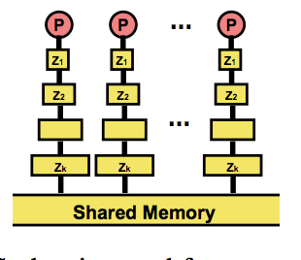
Layout of PMDH

Slide 24
PMDH Bound
Let B_{i} be the block size of the ith cache, and let M_{i} the size of the cache.
Then: Qp(n; M_{i}, B_{i}) < Q(n;M_{i}, B_{i}) + O(pM_{i}D/B_{i}).

Slide 25
Strengths
The paper does a good job developing a simple model that accounts for cache locality.
Solid theoretical analysis.
Sorting is a core problem in many serial and parallel computations so it’s a very useful primitive.
Extension to multi layer caches.

Slide 26
Weakness
Co-Sort is only O(log₂n/log_{M}n) more cache efficient than merge sort but is significantly more complicated and uses more external memory.
No real world results presented; this would have been very useful to see how their model of caches matched reality.

Slide 27
Future Work
Generalizing result to more realistic cache models.
Analyzing parallel cache oblivious algorithms with high depth.

Slide 28
Questions?
Thanks!

